Slide 1

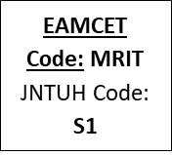
MALLA REDDY INSTITUTE OF TECHNOLOGY AND SCIENCE
An UGC Autonomous Institution
Approved by AICTE New Delhi and Affiliated to JNTU An ISO 9001: 2015 Certified Institution Accredited by NBA and NAAC ‘A’ Grade
Maisammaguda, Medchal (Dist), Hyderabad -500100, Telangana.
Email : mrits.s1@gmail.com, www.mrits.ac.in
DEPARTMENT OF COMPUTER SCIENCE AND ENGINEERING
(ARTIFICIAL INTELLEGENCE AND MACHINE LEARNING)
Deep Learning Applications In Medical Image Analysis - Brain Tumor
PRESENTED BY:
N LIKHITH REDDY 21S11A6687
D ANIKETH 21S11A6671
T MANOHAR 21S11A6689
A VINAY 21S11A66C5
UNDER GUIDENCE OF:
Dr. VAKA MURALI MOHAN
B. Tech, M. Tech, Ph.D.
Principal & Professor of CSE

Slide 2
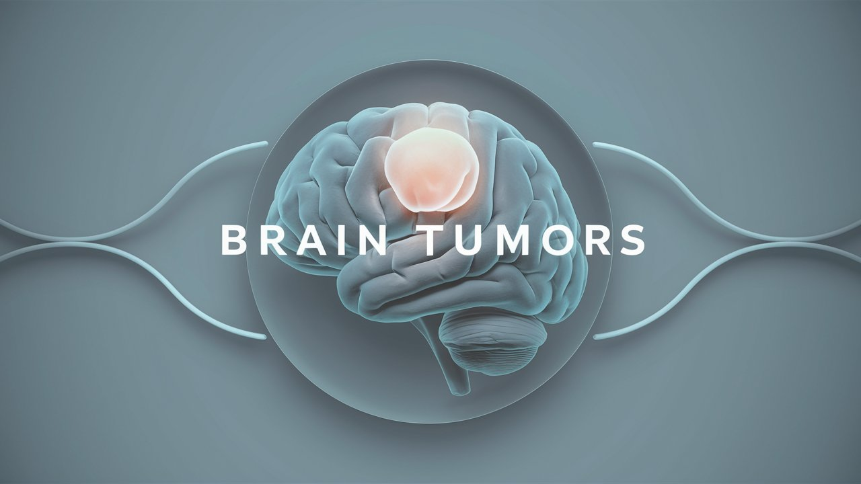
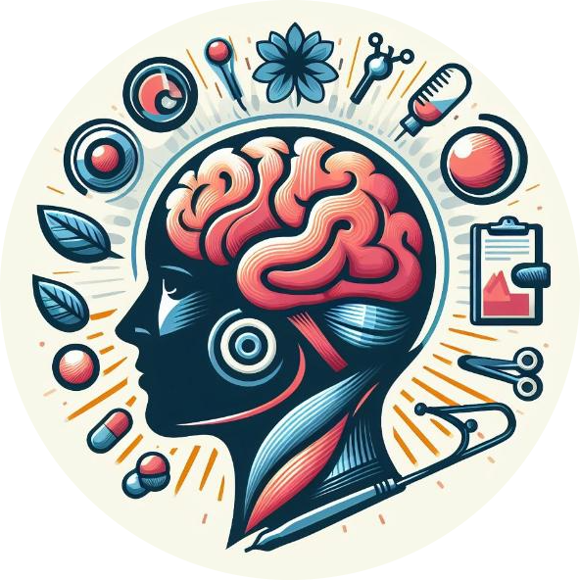

Deep Learning Applications In Medical Image Analysis

Slide 3


Agenda
ABSTRACT
INTRODUCTION
EXISTING METHOD
PROPOSED METHOD
FLOW CHART
HARDWARE AND SOFTWARE REQUIREMENTS
ADVANTAGES
APPLICATIONS
RESULT
CONCLUSION

Slide 4

Abstract
The project focuses on detecting neurological disorders in the brain using unsupervised machine learning and CNN methods, aiming for high accuracy in diagnosis.
Early detection of brain diseases like brain tumors and epilepsy is crucial for effective treatment, highlighting the importance of advanced diagnostic techniques.
The study reviews recent machine learning approaches specifically tailored for identifying these brain diseases, emphasizing their potential in medical diagnostics.
The integration of unsupervised machine learning and CNN in this project demonstrates a promising advancement in the field of neurology, offering improved methods for early disease detection.

Slide 5


Introduction
Machine learning algorithms are revolutionizing medicine, from drug discovery to clinical decision-making, as they can analyze vast amounts of digitalized medical data, including electronic health records (EHRs) and medical images.
The increasing prevalence of EHRs, which include medical images, presents a significant opportunity for machine learning to enhance diagnostic accuracy and efficiency, potentially overcoming limitations faced by human errors.
Machine learning in medical image analysis improves patient outcomes and helps understand how patients interact with AI-driven healthcare decisions.

Slide 6

Existing Method
MRI images often have noise and interference, making it hard for doctors to detect tumors early.
Detecting tumors early is not only difficult, but also takes many days manually.
These challenges cause problems in the medical field.
Disadvantages
Detecting tumors manually from noisy MRI images takes a lot of time.
Early detection of tumors is difficult because of poor image quality.
These issues lead to delays and errors in diagnosis.

Slide 7

Proposed Method
Input and Preprocessing:
Uses X-ray/CT scan images of brain tumors and healthy brains, resized to 256 × 256 pixels.
Converts images to arrays and applies preprocessing.
Data Splitting:
Divides data into 70% training, 20% validation, and 10% testing sets for balanced model training and evaluation.
Model Training:
Trains a machine learning model using the preprocessed images to distinguish between brain tumors and healthy brain images.
Evaluation and Testing:
Validates the model's performance using the validation set.
Tests the final model on the testing set to assess its accuracy and reliability in detecting brain tumors.

Slide 8
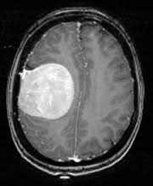


Flow Chart
Edge Detection
Shape Analysis
Input X-ray Image
Image Preprocessing
Features Extraction
Noise Reduction
Resizing
Brain Tumor Classification
Brain Tumor Segmentation
Trained CNN Brain Tumor Detection Model

Slide 9




Hardware and Software Requirements
Hardware Requirement:
System Processor : Pentium IV 2.4 GHz or above
Hard Disk : 20 GB or above
Monitor : 10/12/15 VGA color
Ram : 4GB or above
Software Requirement:
Operating system : Windows 7/8/10/11.
Programming Language : python 3.7
Type of Application : Graphical User Interface
Frontend Technologies : Tkinter, CNN with supported libraries
Backend Technologies : matplotlib, TensorFlow, Keras, etc.
Dataset : X-ray/CT scan image (Brain)

Slide 10
Advantages
Better Accuracy: Detects tumors more accurately than traditional methods.
Faster Processing: Quickly analyzes large amounts of medical images.
Consistent Results: Provides uniform outcomes, reducing human error.
Automated: Reduces the need for manual analysis by doctors.

Slide 11
Applications
Finding Tumors: Identifies tumors in MRI and CT scans.
Classifying Tumors: Determines the type and grade of tumors.
Planning Surgery: Helps doctors plan where to operate.
Tracking Tumors: Monitors how tumors change over time.

Slide 12
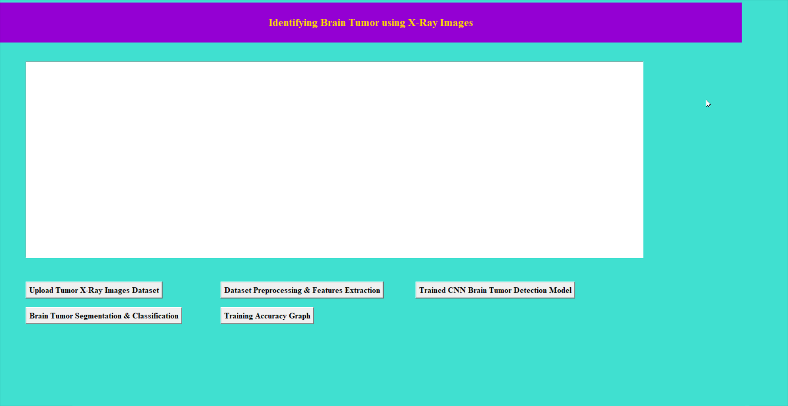
Result
To upload dataset in above screen click on “upload Tumor X-Ray Images Dataset’ button and get below output.

Slide 13
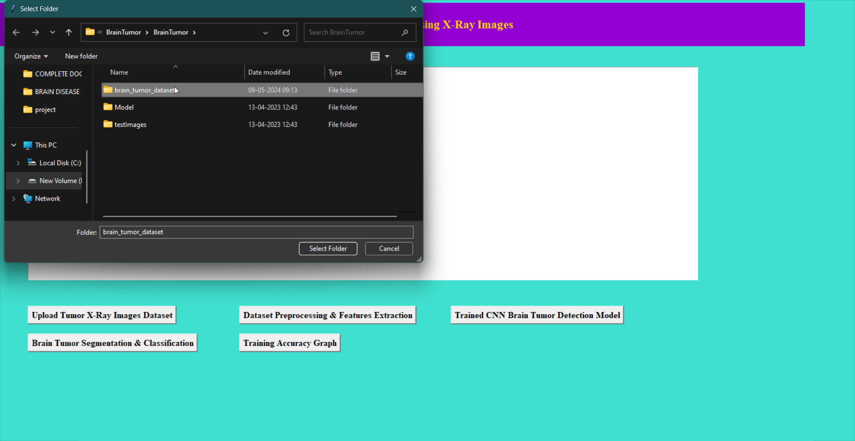

Result
In above screen selecting and uploading ‘brain tumor dataset’ dataset folder and then click on ‘Select Folder’ button to upload dataset and to get below output

Slide 14

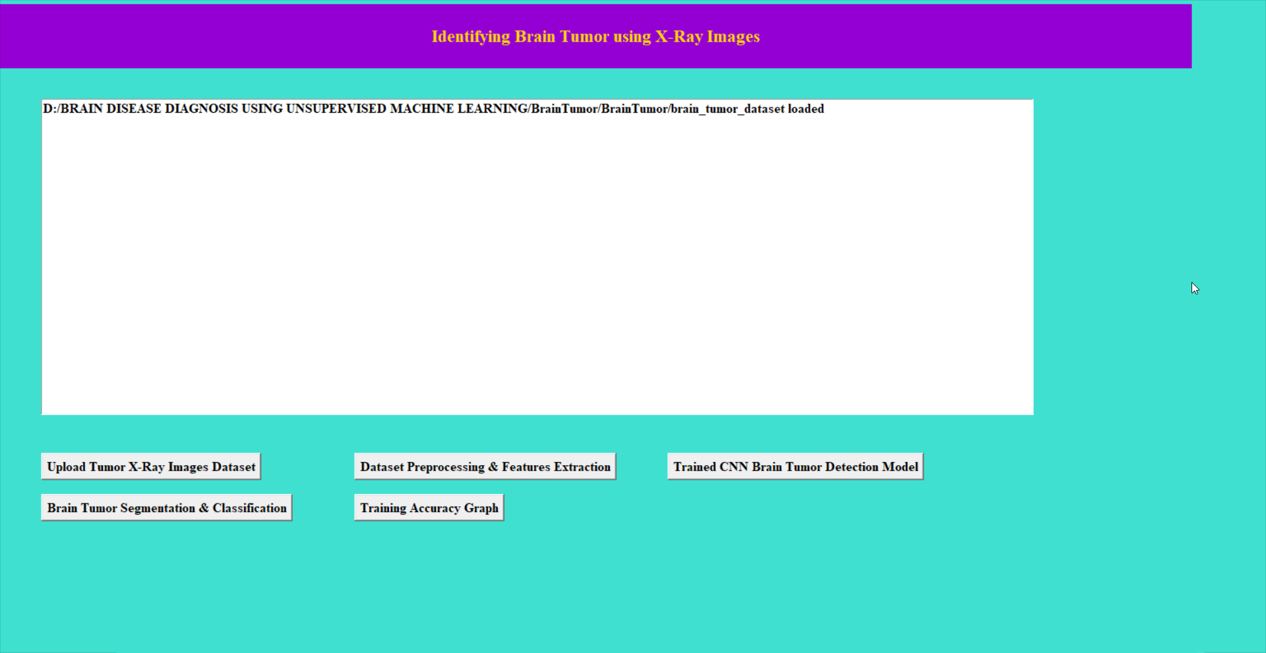
Result
In above screen dataset loaded and now click on ‘Dataset Preprocessing & Features Extraction’ button to normalize image and get below output.

Slide 15
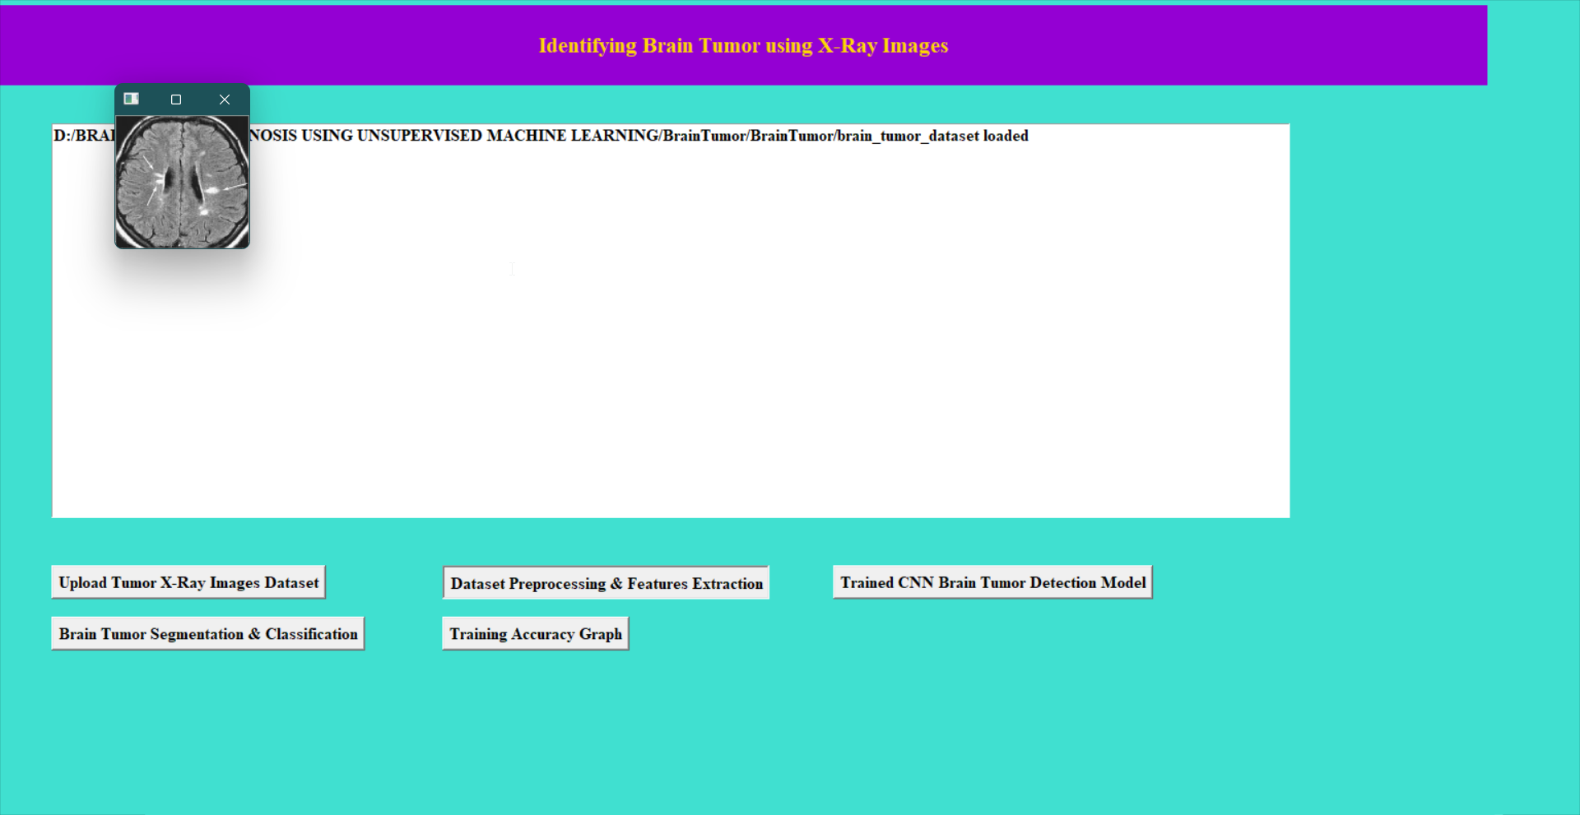

Result

Slide 16
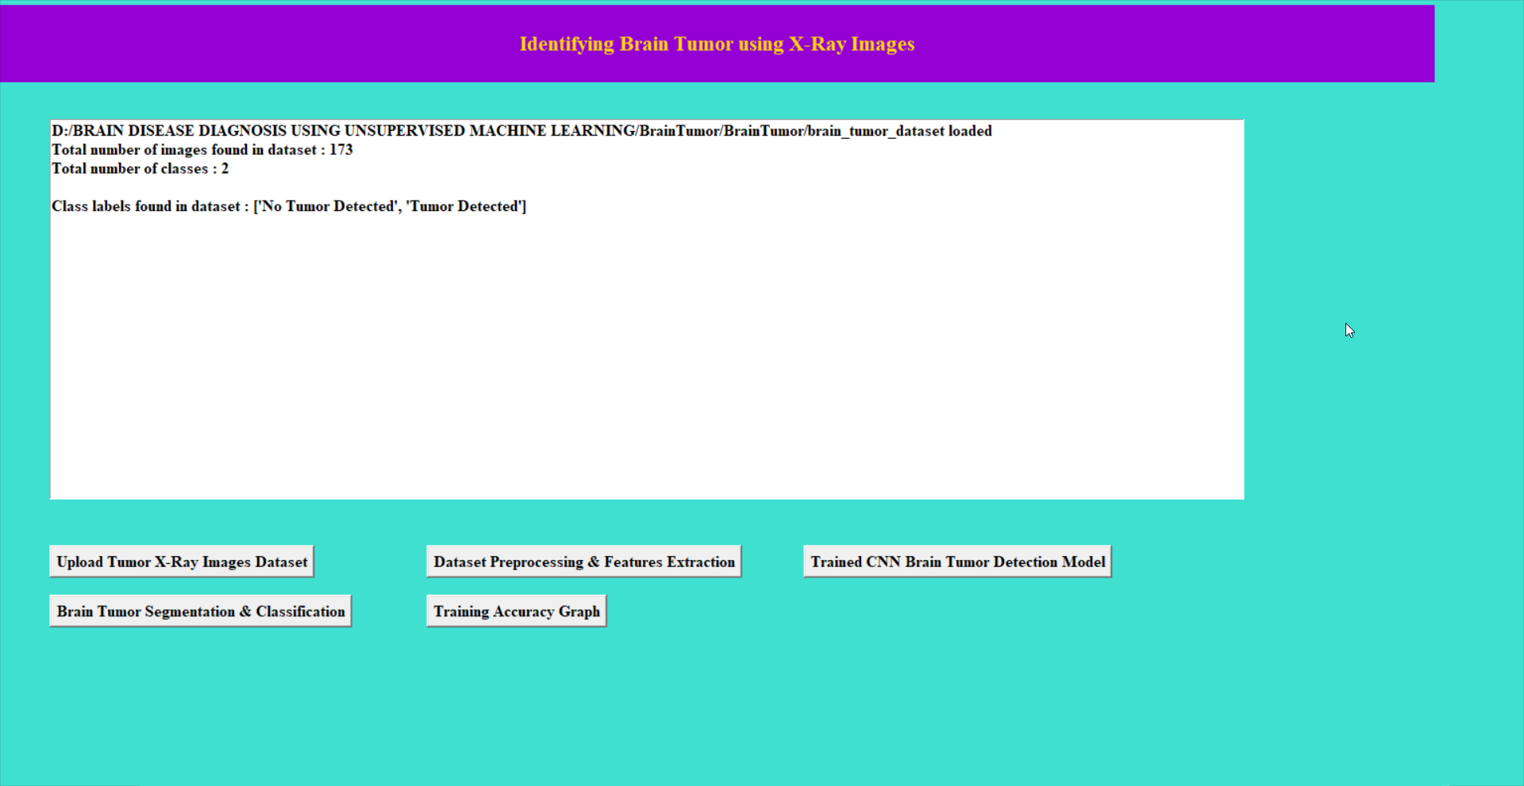
Result
In above screen all 173 images from dataset are normalized and number of classes are 2 and labels found in dataset are ‘No Tumor Detected’, ‘Tumor Detected’ now click the ‘Trained CNN Brain Tumor Detection Model’ Button to Train and view the Model.

Slide 17
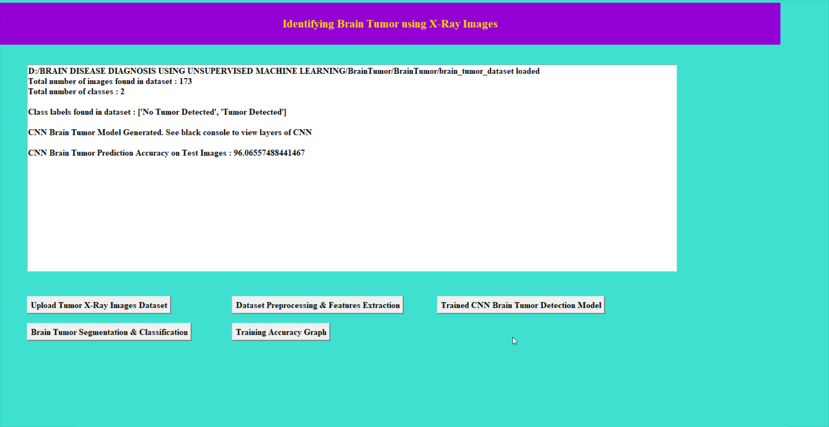
Result
In above screen we can see that the Brain Tumor Model Generated and the Accuracy on Test Images is 96.06% and Now click on the ‘Brain Tumor Segmentation & Classification’ Button to Predict the Brain Tumor for New X-ray Image.

Slide 18
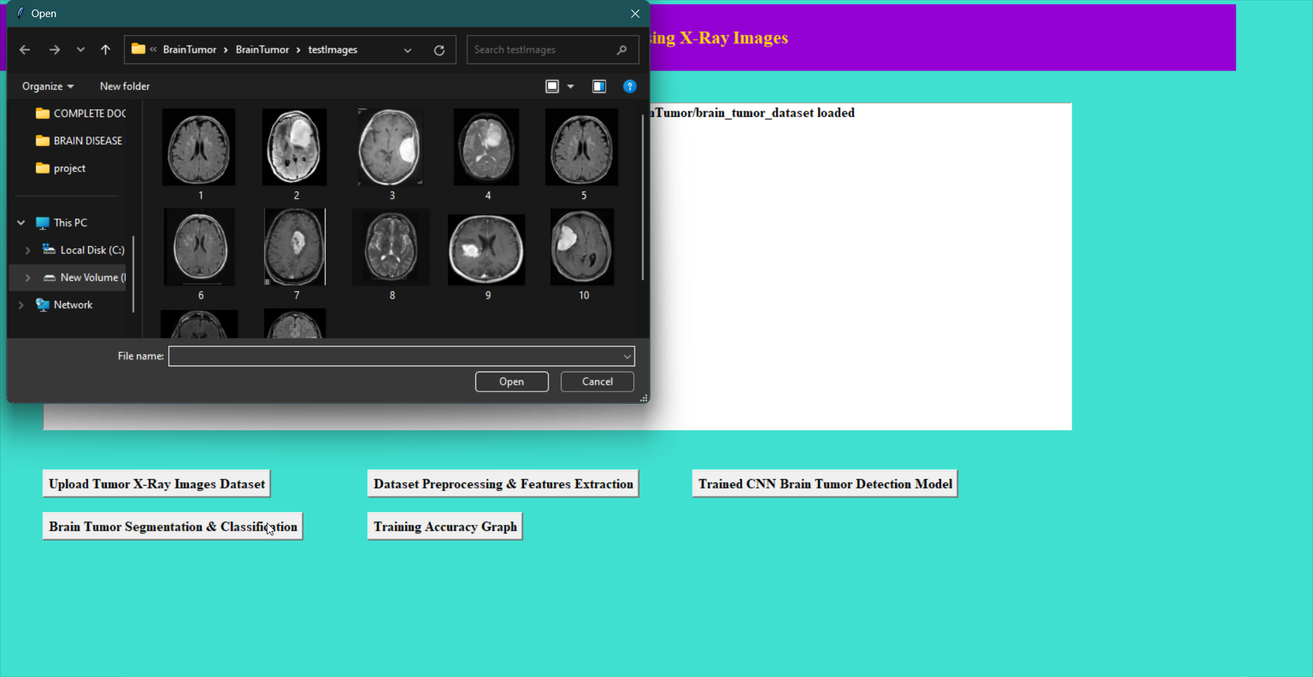
Result
Select the Image to Detect the Brain Tumor and click on Open Now it will generate the result and display the result as below screen.

Slide 19
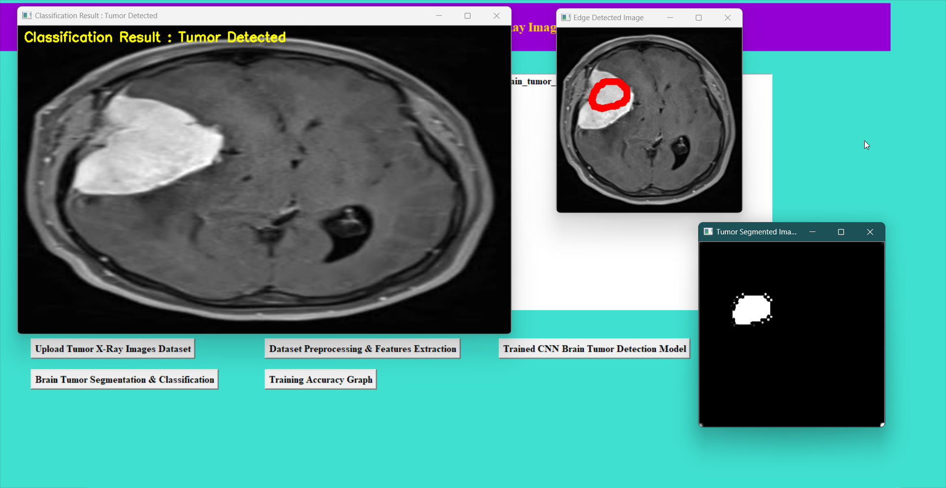
Result
This is the result of the Brain Tumor for New X-ray image and it also shows the location of the Brain Tumor with also segmented Image. And next click on ‘Training Accuracy Graph’ button to view the Graph.

Slide 20
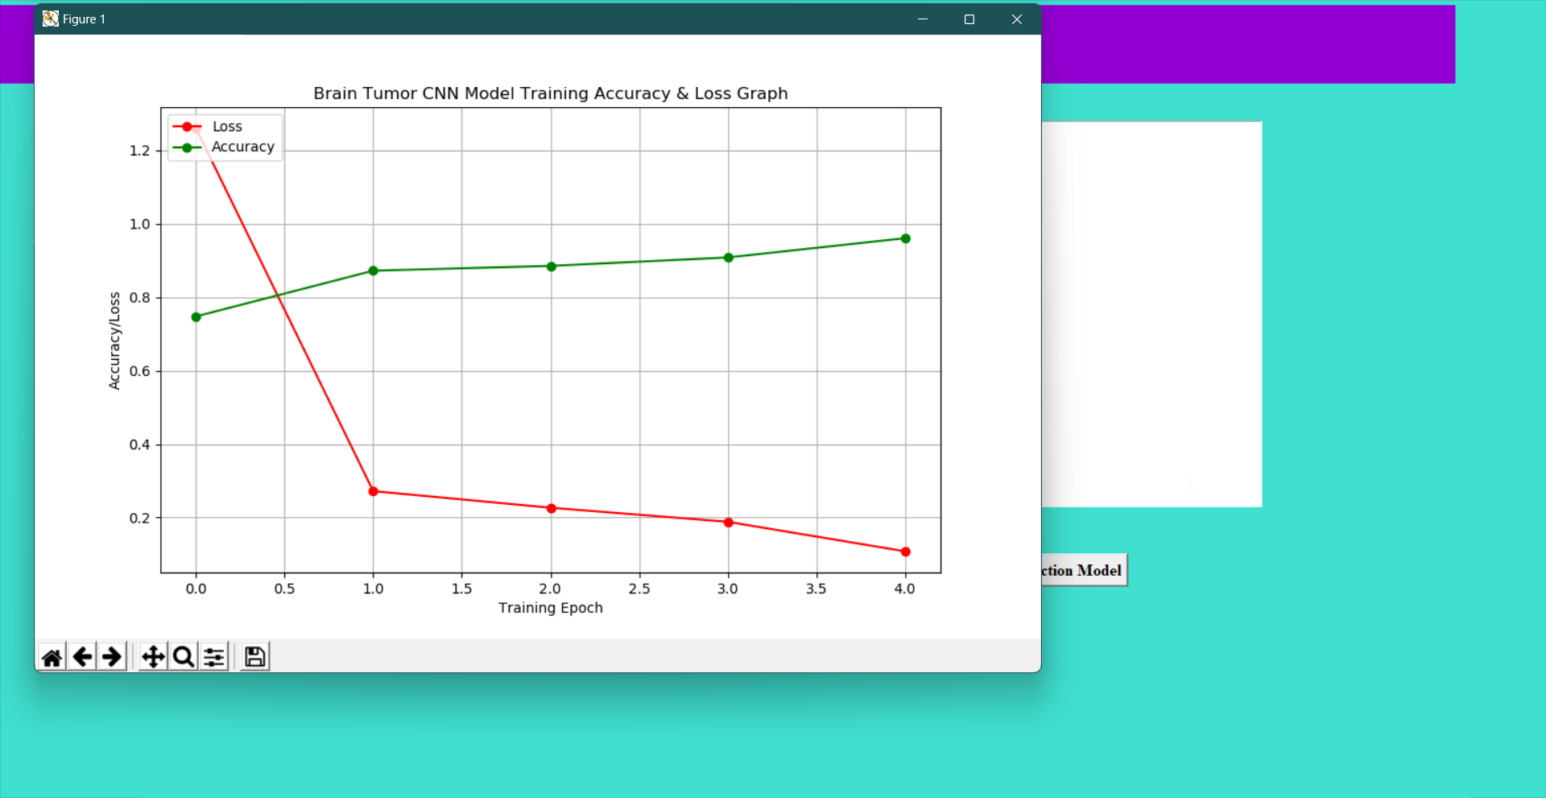
Result
This is the Graph of Accuracy/Loss vs Training Epoch Graph and shows for every increase in epoch the loss decreases and accuracy increases.

Slide 21
Conclusion
Improving accuracy in brain disease detection through ML/DL requires more data, hybrid algorithms for clinical integration.
Challenges include data quality, resource efficiency, and addressing data management, security, and privacy issues.
For accurate diagnosis of tumor patients, an appropriate segmentation method is required for MRI images to improve diagnosis and treatment.
Brain Tumor detection aids physicians and benefits the medical imaging industry, especially those producing MRI images.

Slide 22
